Slide 1

Understanding FlutterPackages and Plugins
Integrating Third-Party Plugins & Case Studies: Popular Flutter Plugins
Notes:
This presentation will provide an overview of Flutter packages and plugins, including their benefits, challenges, and how to integrate them into your Flutter projects. We will also explore some popular third-party plugins and discuss best practices for using them.

Slide 2

Introduction
What are Flutter packages and plugins?
Reusable pieces of code that extend the functionality of your Flutter app
Packages are official Flutter libraries, while plugins are third-party libraries
Thousands of packages and plugins available on Pub.dev, the official repository
Notes:
Flutter packages and plugins are powerful tools that can help you save time and effort when building your Flutter apps.
They provide a wide range of functionality, from networking and storage to social media and payments.

Slide 3

TYPES OF PACKAGES AND PLUGINS
Official Flutter packages: Developed and maintained by the Flutter team
Community-maintained packages: Created and maintained by the Flutter community
Third-party plugins: Developed and maintained by independent developers
Packages and plugins are categorized based on their functionality (e.g., networking, storage, navigation)
Notes:
It is important to choose the right type of package or plugin for your needs. Official Flutter packages are typically the most reliable and well-maintained, but they may not offer all the features you need. Community-maintained packages and third-party plugins can offer more flexibility and functionality, but they may not be as reliable or well-supported.

Slide 4


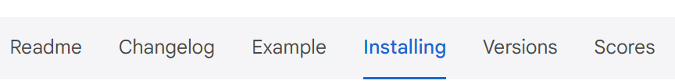

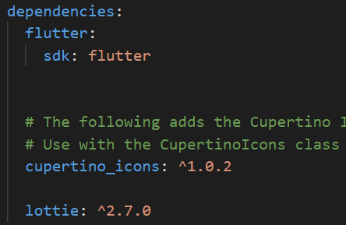
FINDING AND INSTALLING PACKAGES AND PLUGINS
Search for packages and plugins on Pub.dev
Browse by category or search by keyword
Read the package documentation and reviews
Install the package or plugin using the flutter pub get command
Notes:
Pub.dev is the official repository for Flutter packages and plugins. It is a great resource for finding the right package or plugin for your needs. Once you have found a package or plugin, be sure to read the documentation and reviews before installing it.

Slide 5

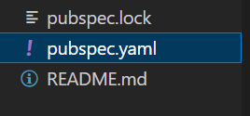
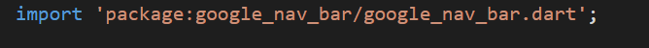
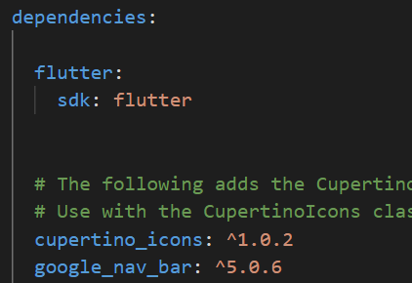
Integrating Third-Party Plugins
Add the plugin to your pubspec.yaml file
Import the plugin in your code
Configure the plugin
Use the plugin methods in your code
Notes:
Integrating a third-party plugin is typically a straightforward process. However, it is important to follow the specific instructions provided by the plugin author. Be sure to test your code thoroughly after integrating a new plugin. Let’s see steps:
step1:Add the plugin to your pubspec.yaml file:
Open your pubspec.yaml file.
Under the dependencies section, add the plugin along with its version.
step2:Import the plugin in your code:
In the file where you want to use the plugin, import it at the top of the file.
step3:Configure the plugin:
Depending on the plugin, you may need to configure it before using it.
step4:Use the plugin methods in your code:
Now that the plugin is imported and configured, you can use its methods in your code. These methods will vary depending on the functionality provided by the plugin.

Slide 6
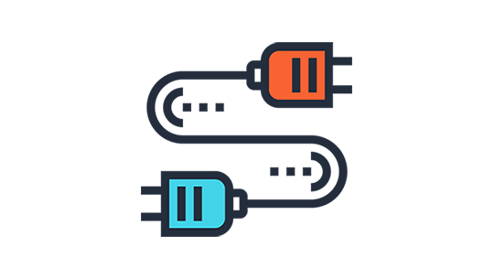
Case Studies: Popular Flutter Plugins
Social Media: Facebook, Twitter, Google Sign In
Location and Maps: Google Maps, HERE Maps, Mapbox
Navigation: Navigator 2.0, GoRouter, BottomNavigationBar
Storage: SharedPreferences, Hive, Path Provider
Networking and HTTP: Dio, Retrofit, http
Payments: Stripe, PayPal, Braintree
Notes:
There are many popular Flutter plugins available, each offering different features and functionality. This slide provides a brief overview of some of the most popular plugins in different categories.

Slide 7
Best Practices for Using Packages and Plugins
Choose the right packages and plugins for your needs
Use stable versions of packages and plugins
Keep your packages and plugins updated
Understand the license and dependencies of your packages and plugins
Avoid conflicts
Notes:
When choosing a plugin, be sure to consider your specific needs and requirements:
Choose the right packages and plugins for your needs: In Flutter, there are numerous packages and plugins available for various functionalities like UI design, state management, networking, etc. It's crucial to select ones that align with the requirements of your project.
Use stable versions of packages and plugins: Flutter packages are often updated with new features and bug fixes. However, it's essential to use stable versions for production-level projects. Stable versions have undergone rigorous testing and are less likely to have issues or breaking changes compared to beta or alpha versions.
Keep your packages and plugins updated: Regularly check for updates to the packages and plugins used in your Flutter project. Updates may include performance improvements, bug fixes, and new features. Keeping your dependencies up-to-date ensures your project remains efficient, secure, and compatible with the latest Flutter SDK versions.
Understand the license and dependencies of your packages and plugins: Each Flutter package comes with its own license, which dictates how you can use the software. It's essential to understand and comply with these licenses to avoid legal issues. Additionally, be aware of the dependencies of the packages you use, as they may introduce additional dependencies or licensing requirements.
Avoid conflicts: When using multiple Flutter packages in a project, conflicts may arise due to incompatible versions or overlapping functionality. To avoid conflicts, carefully manage your dependencies and ensure that the packages you use work well together.

